Slide 1



Exploring the Feasibility to make a “Paint Battery”
Andreas Grasser, 26.06.2021

Slide 2

Motivation
Battery production has many steps
In-situ production often impossible
More steps → more expensive
Reduction of production steps can lead to lower prices and broader applications

Slide 3
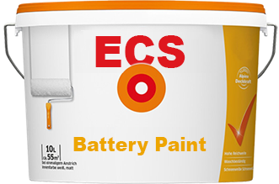
Final goal
One paint that produces the three layers of a battery by itself:
cathode
gel electrolyte / seperator
anode
“Wall paint that forms a battery”
https://www.obi.de

Slide 4
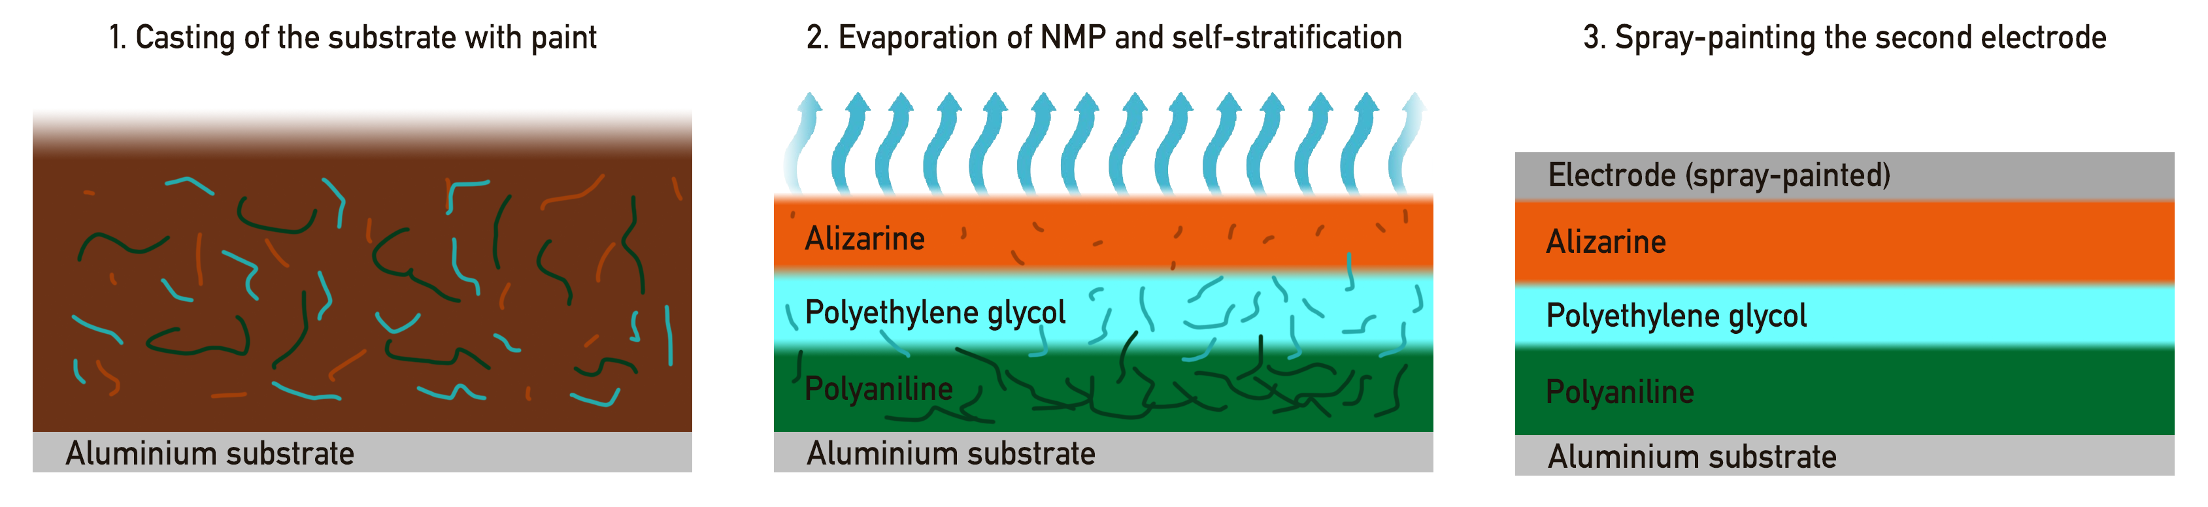
Final goal

Slide 5
Possible steps
Solvability experiments with the components
Simple phase separation experiments
Manually assembled battery using spin-coating etc. for benchmark
“Hybrid” battery with self-stratification of two layers + one spin-coated layer
Complete battery using self stratification
Further improvements
Reality: not that straight forward

Slide 6
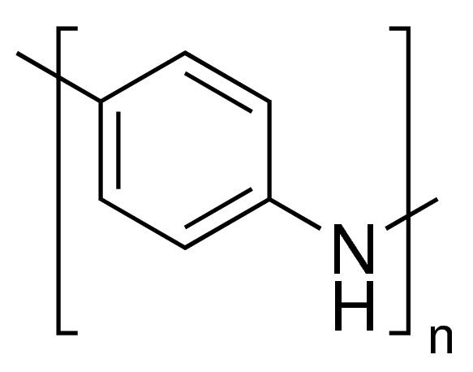
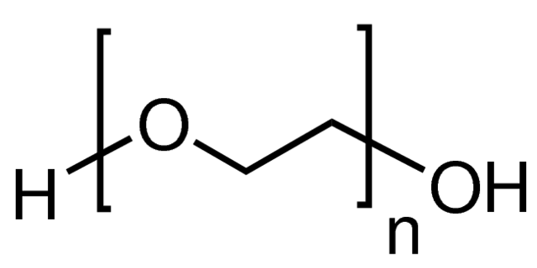
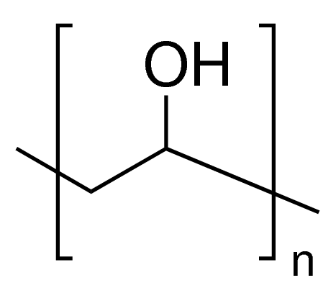
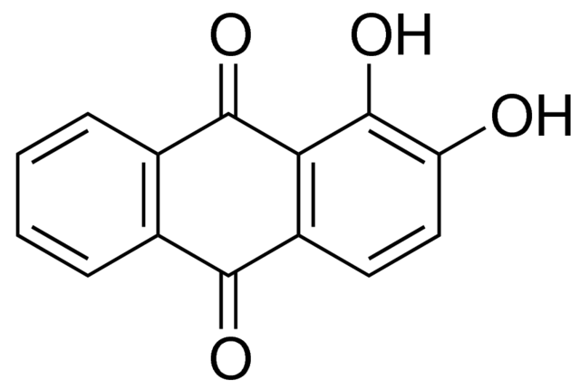
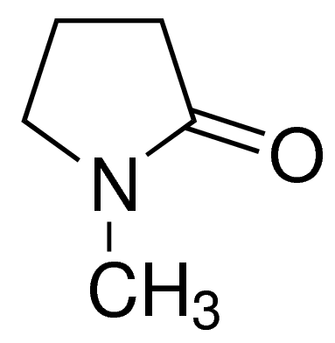
Final goal
Main material focus:
Polyaniline (PANI)
Polyethylene glycol (PEG)
Polyvinyl alcohol (PVA)
Alizarin
N-Methyl-2-pyrrolidone (NMP)
https://www.sigmaaldrich.com

Slide 7
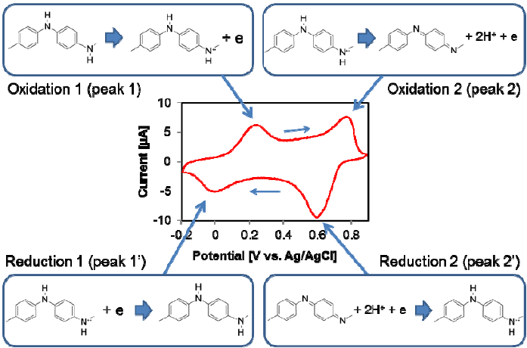
Polyaniline reduction / oxidation
Song, Edward & Choi, Jin-Woo. (2013). Conducting Polyaniline Nanowire and Its Applications in Chemiresistive Sensing. Nanomaterials. 3. 498-523. 10.3390/nano3030498.

Slide 8
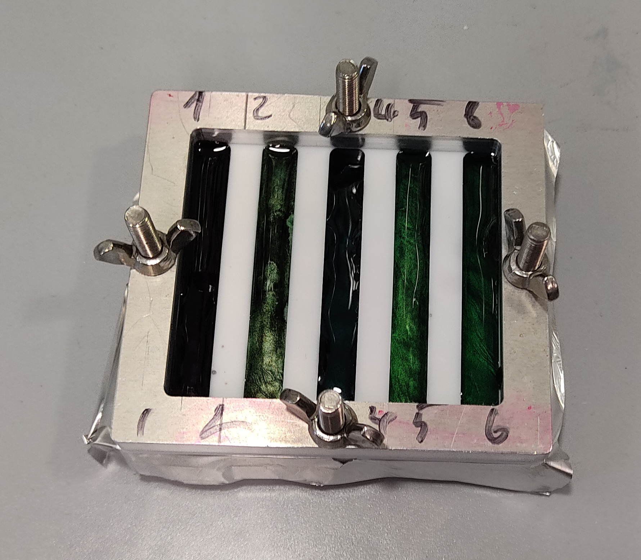
Solvability experiments
One solvent needed for all three polymers
Bottleneck in solvability: PANI
Experiment: PANI with different solvents and different treatments
→ NMP as a good candidate
Solvent has influence on stratification process
Also: PANI with shorter chain length better

Slide 9
Manual Battery
Creating the layers of the battery without self-stratification
Using well-known techniques for battery fabrication
Benchmark for the final battery
Allows to move stepwise towards a complete self stratifying battery

Slide 10
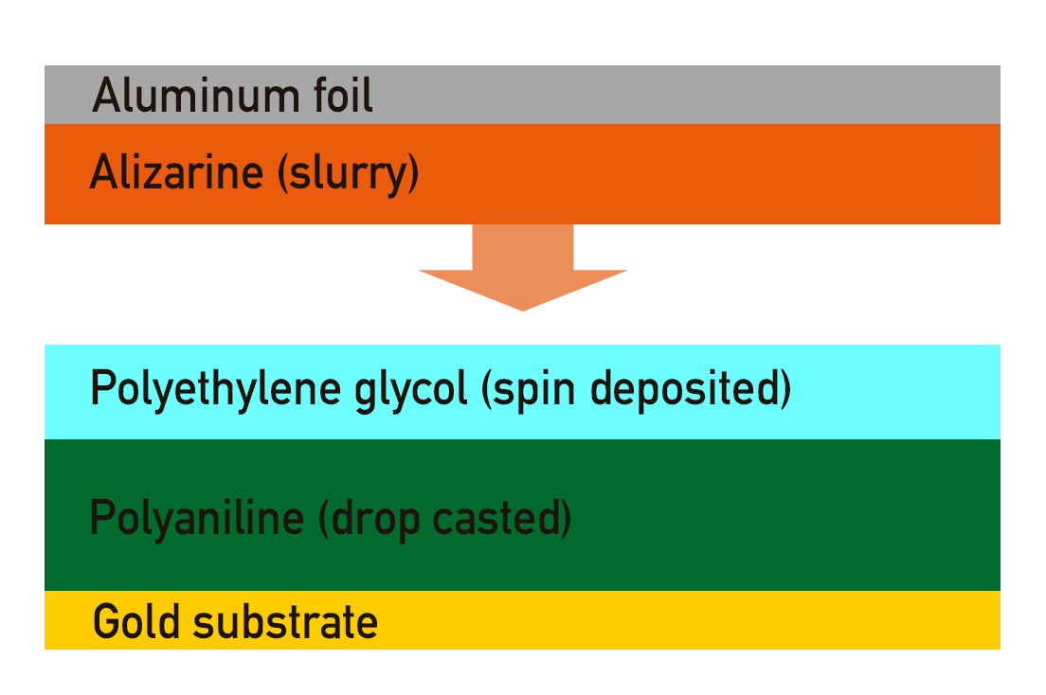
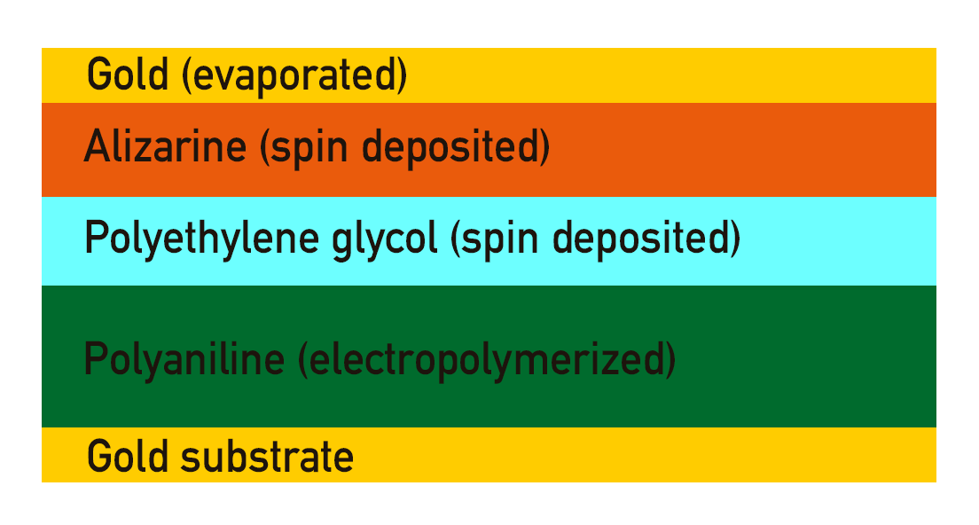
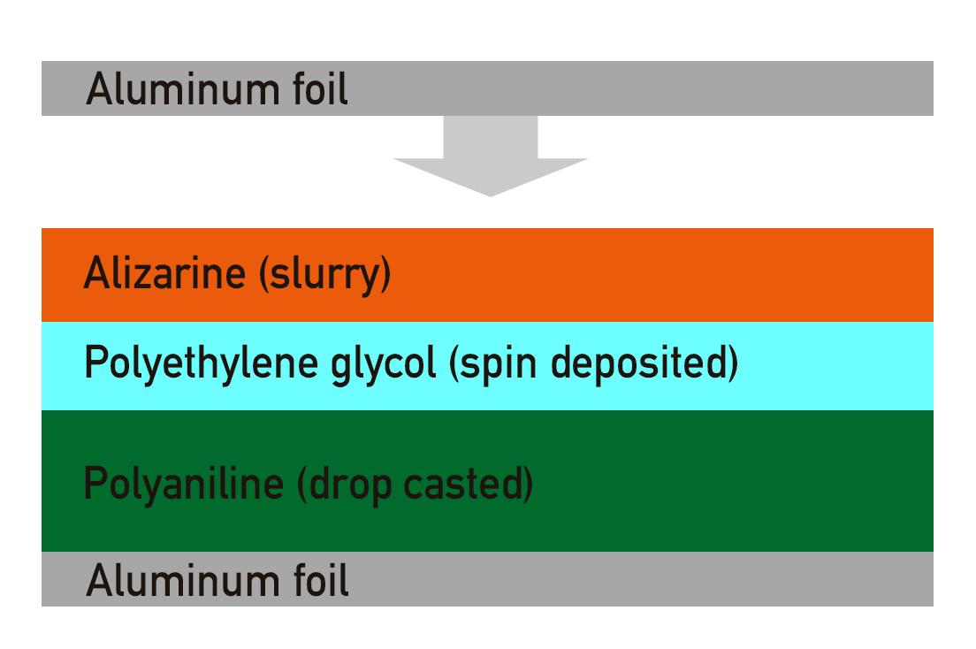
Manual Battery

Slide 11
Manual Battery
Problem: Electropolymerisation of PANI on metal surfaces did not work
Can one dropcast PANI instead of electropolymerize it?
→ CV of drop casted PANI (in 8M NaClO₄)

Slide 12
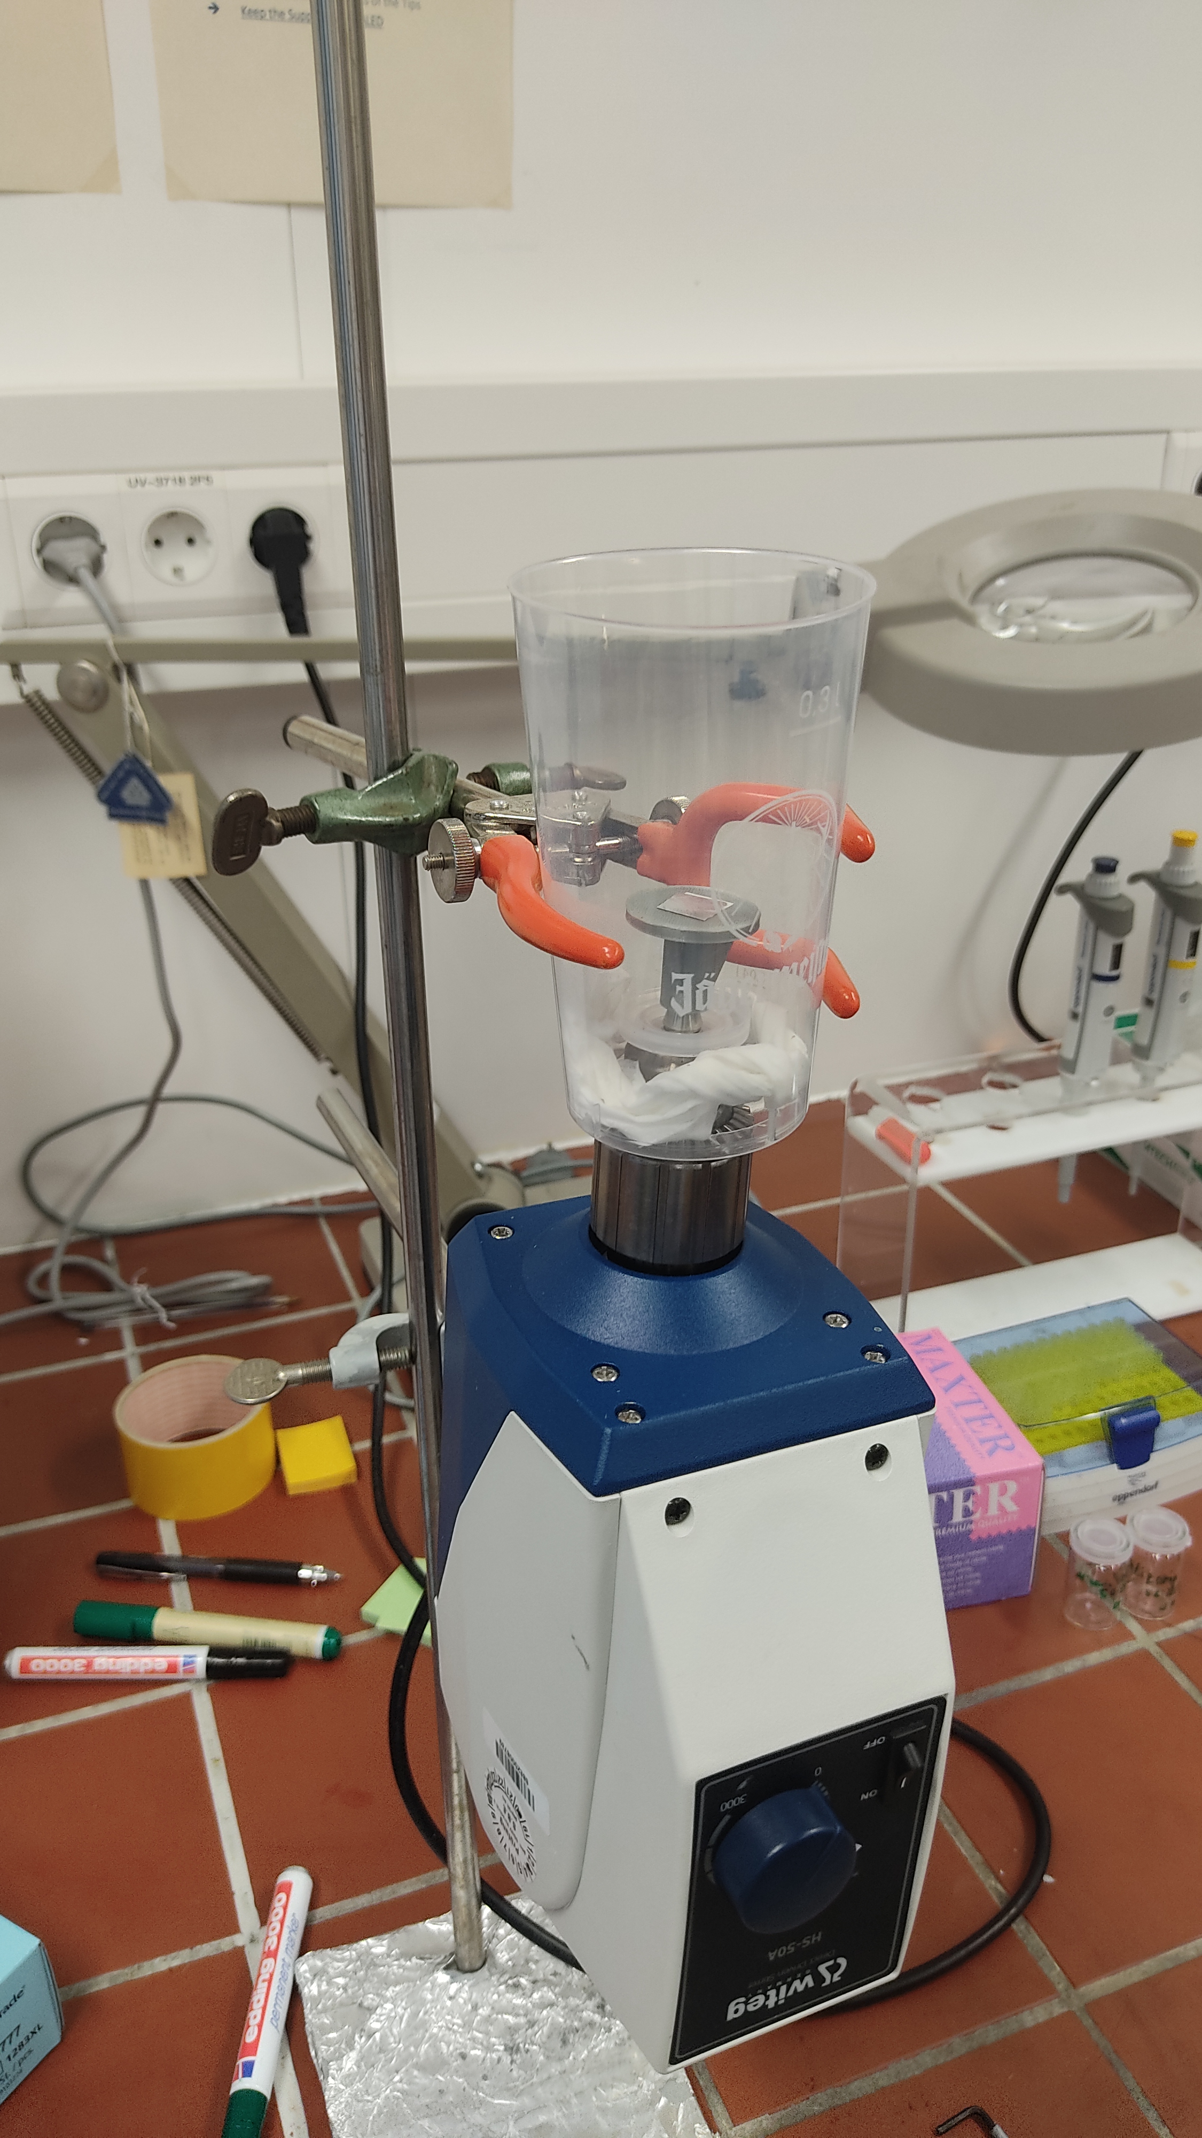
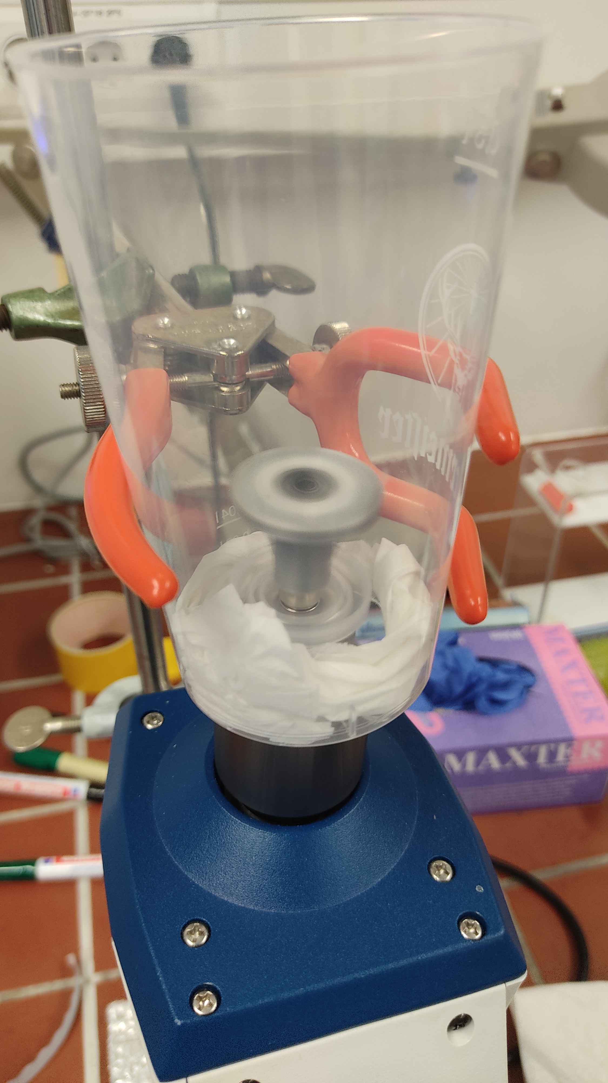
Manual Battery
Using DIY 3D-printed spin coater

Slide 13

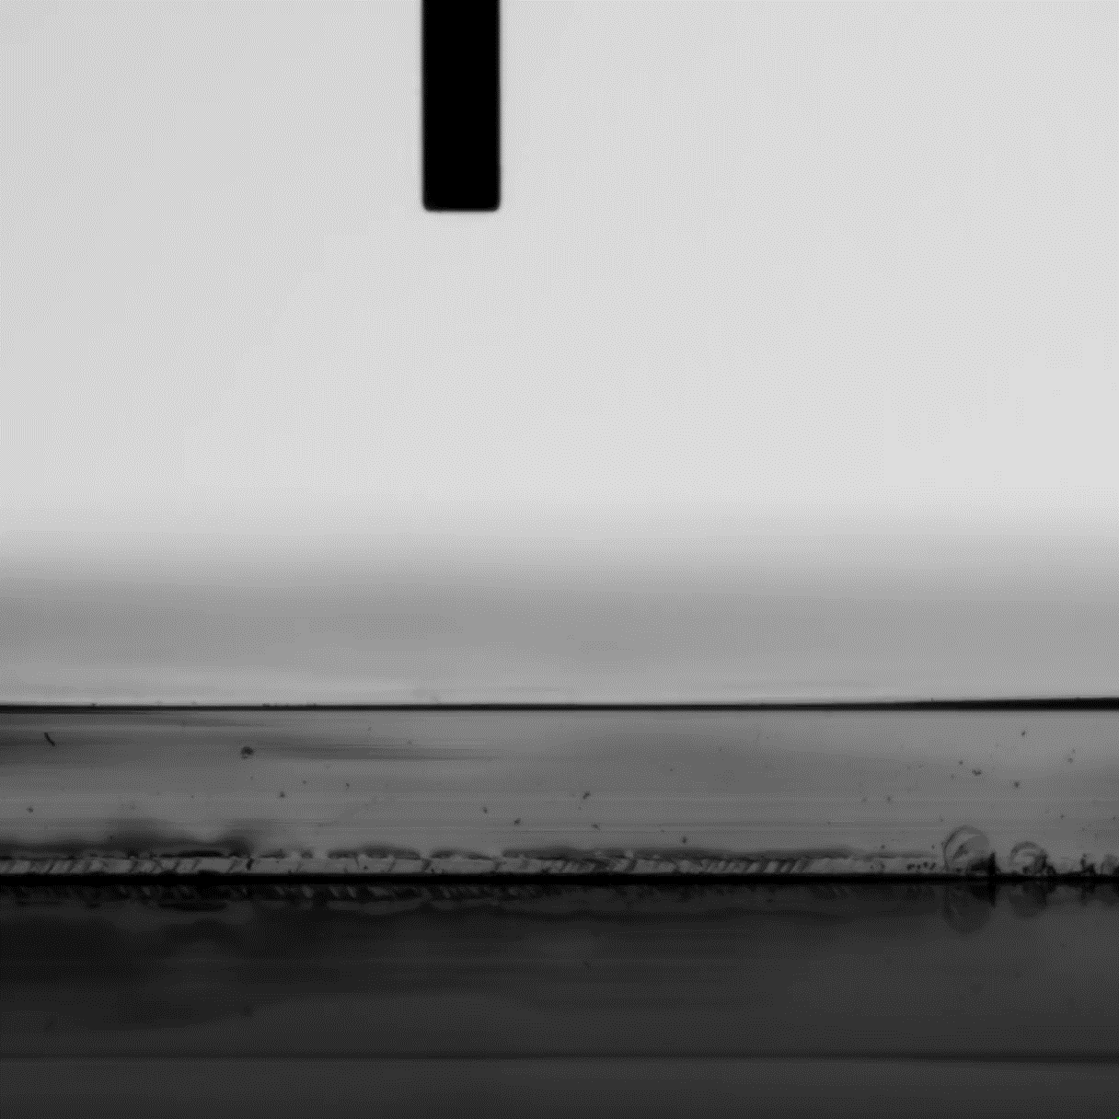
Contact angle measurements
Measure hydrophility of surface
→ possible test for a successful stratification
→ with different liquids: measurement of free surface energy possible
+ Very fast and easy
Many error sources
(soaking into PANI, dirt on surface, different film thickness, …)

Slide 14
Contact angle measurements
Compare contact angle of different samples:
Polyaniline
PVA/PEG
Polyaniline + PVA/PEG
For a successful stratification: contact angle of mixture should show strong tendency towards one of the single components

Slide 15
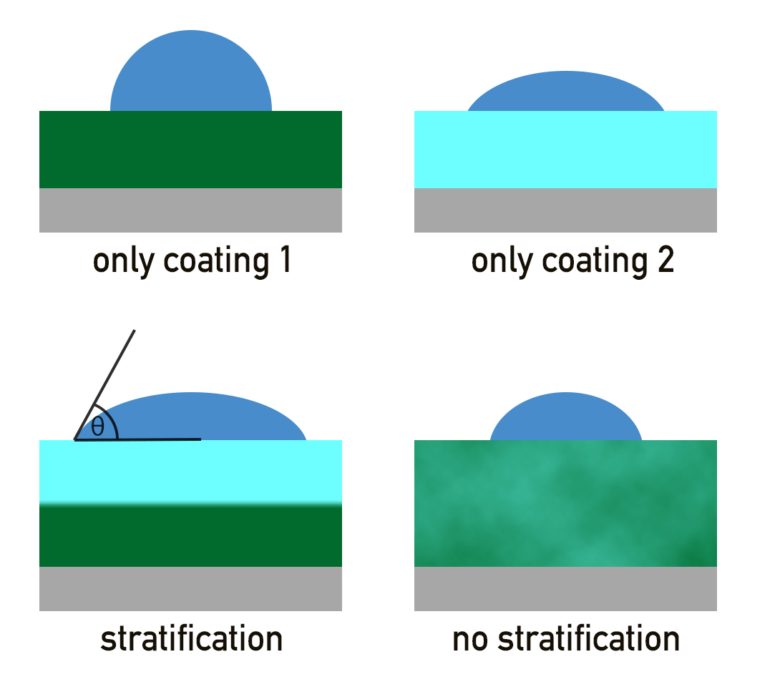
Contact angle measurements

Slide 16
The self-statification process
Driving forces for self-stratification:
Gravity
Selective wetting mechanism
Pigment wetting mechanism
Surface tension gradients
Phase contraction
Two models for predicting self-stratification:
UNIFAC model
Surface energy based model

Slide 17
The surface energy based model
Assumptions:
Surface free energy is main driving force of stratification
Solvent has no influence in stratification
+ Relatively easy to measure and calculate
- Even in an advanced form no perfect prediction possible

Slide 18
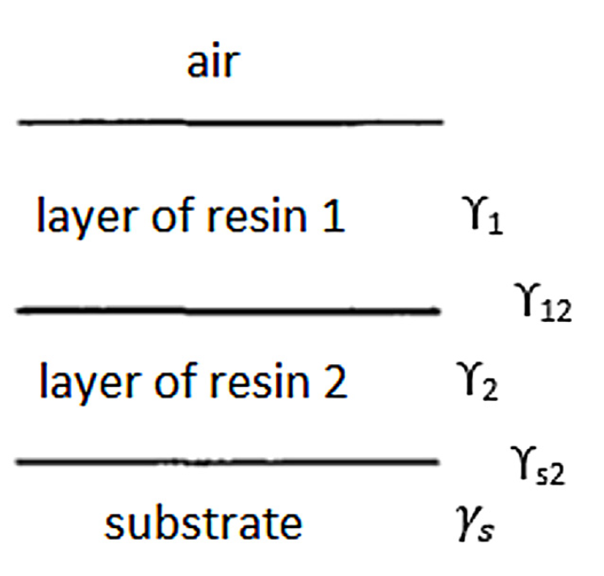
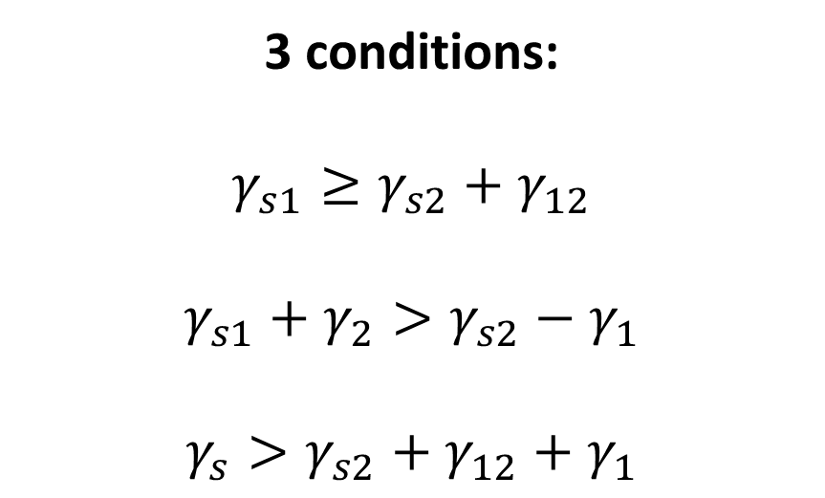
The surface energy based model
3 conditions:
$$γ_{s1}≥γ_{s2}+γ_{12}$$
$$γ_{s1}+γ_{2}>γ_{s2}−γ_{1}$$
$$γ_{s}>γ_{s2}+γ_{12}+γ_{1}$$
Christopher Carr, Eva Wallstöm, Theoretical aspects of self-stratification (1996)
https://doi.org/10.1016/0300-9440(95)00594-3

Slide 19
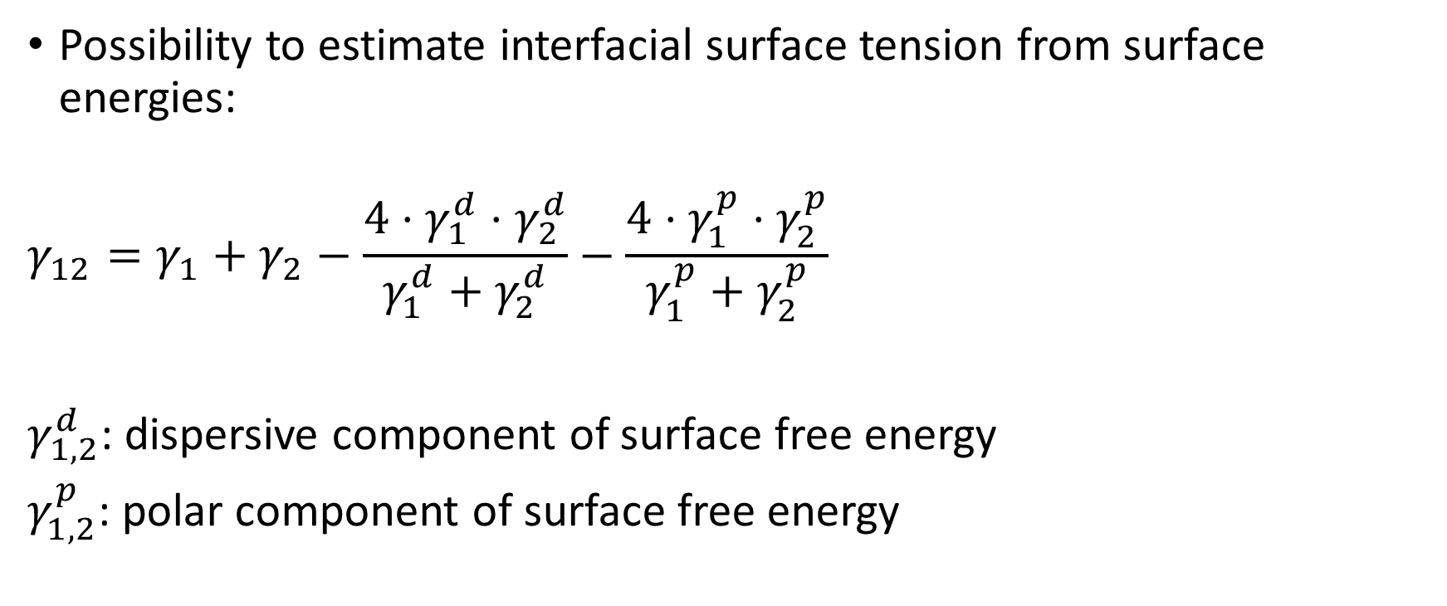
The surface energy based model
Possibility to estimate interfacial surface tension from surface energies:
$$γ_{12}=γ_{1}+γ_{2}−\frac{4⋅γ_{1}^{d}⋅γ_{2}^{d}}{γ_{1}^{d}+γ_{2}^{d}}−\frac{4⋅γ_{1}^{p}⋅γ_{2}^{p}}{γ_{1}^{p}+γ_{2}^{p}}$$
$γ_{1,2}^{d}$: dispersive component of surface free energy
$γ_{1,2}^{p}$: polar component of surface free energy

Slide 20
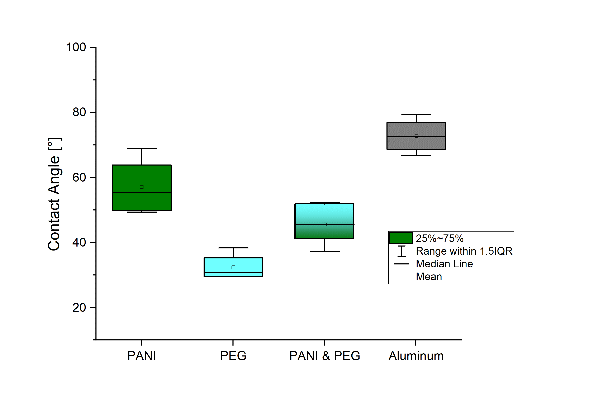
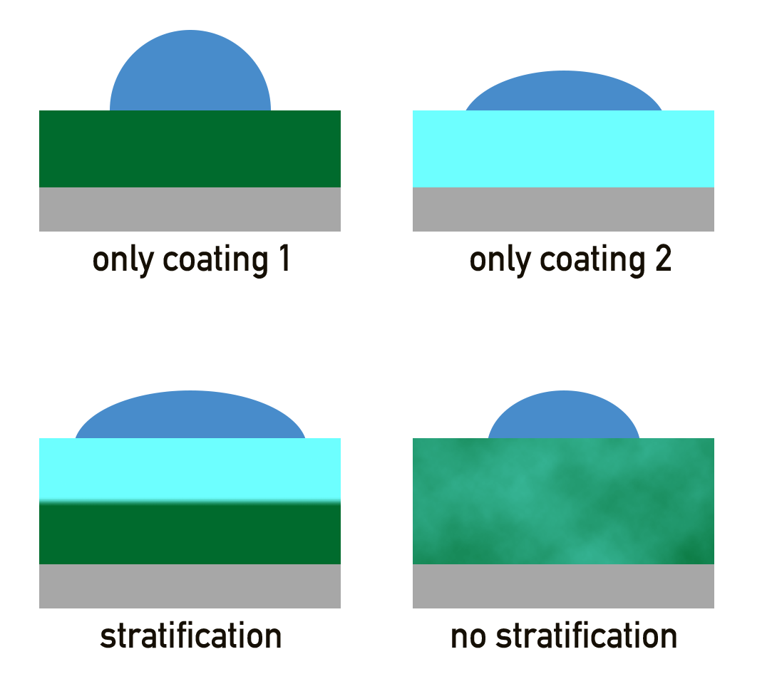
Battery with two layer stratification
No stratification signs for PEG

Slide 21
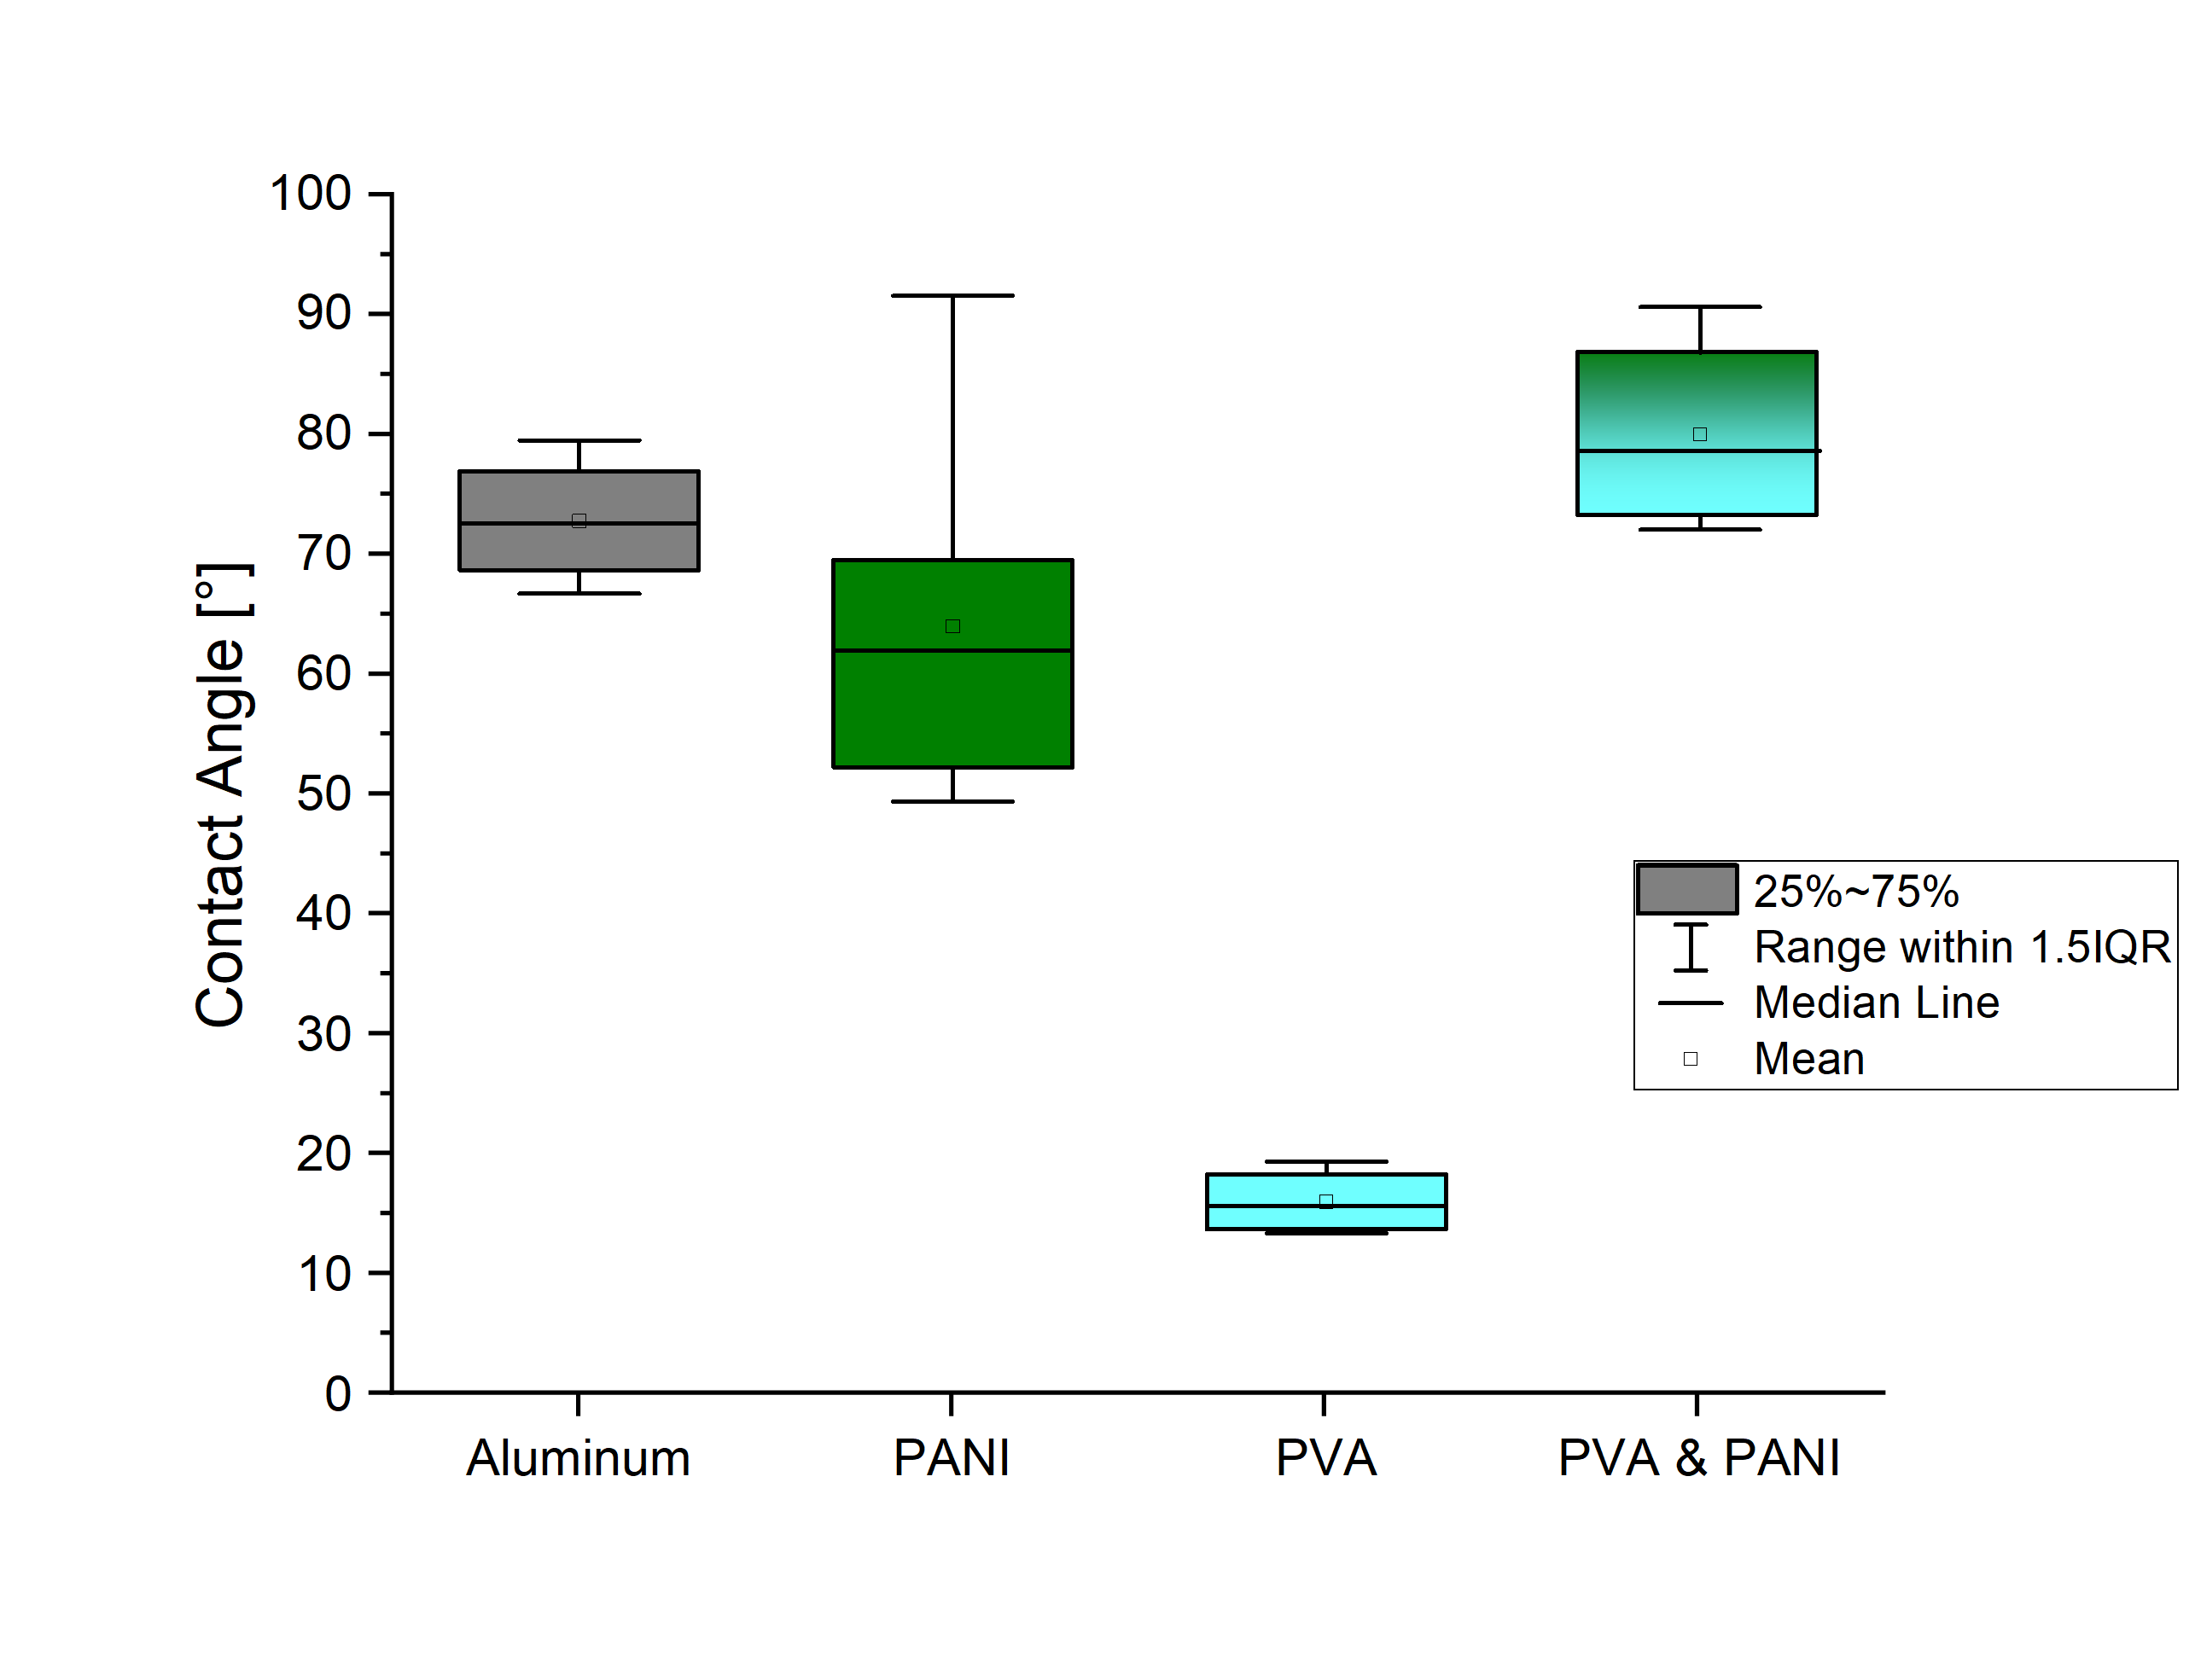
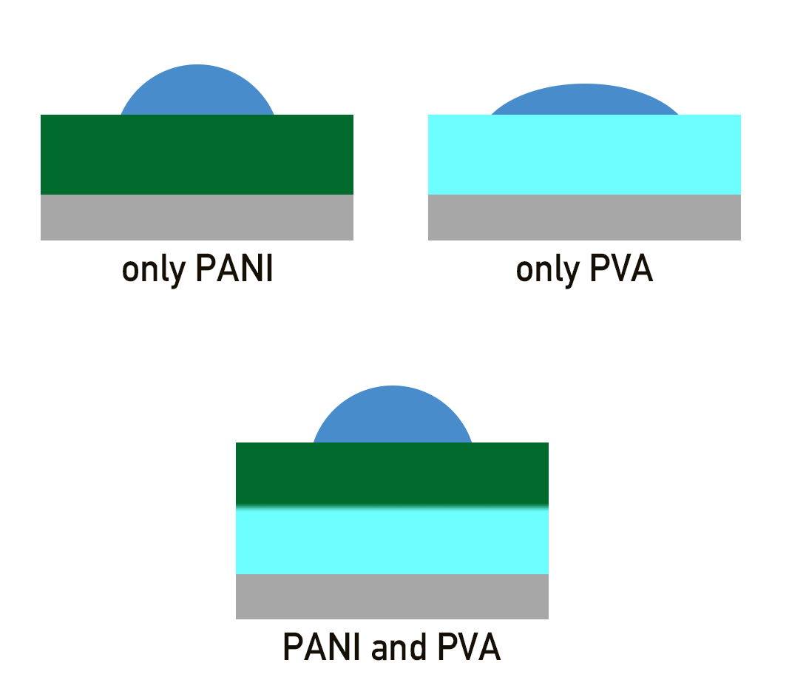
Battery with two layer stratification
Stratification of Polyaniline + PVA on Aluminum foil?

Slide 22
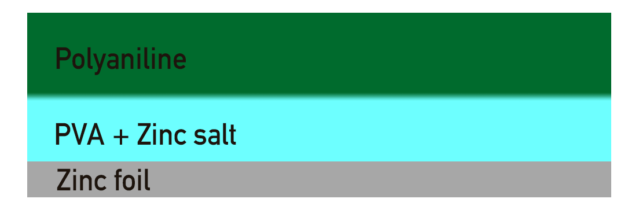
Battery with two layer stratification
Big problem: how to add third layer beneath the coating?
Using a zinc surface as anode and Zinc Perchlorate as conducting salt
Difficulties (?):
Zinc has different surface energy than Aluminum
Zn²⁺ /Cl⁻ instead of Na⁺ ions

Slide 23
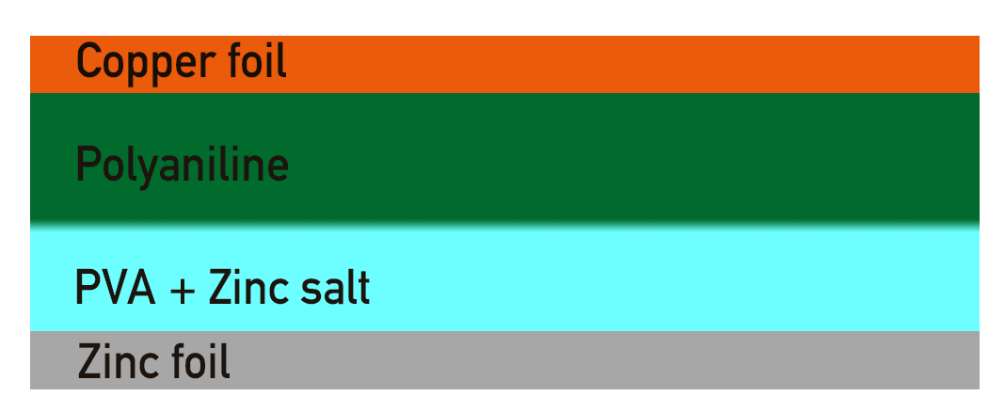
Battery with two layer stratification
First test with copper current collector gave a voltage of ~0.6V
(Reaction directly between zinc ions and copper foil?)

Slide 24
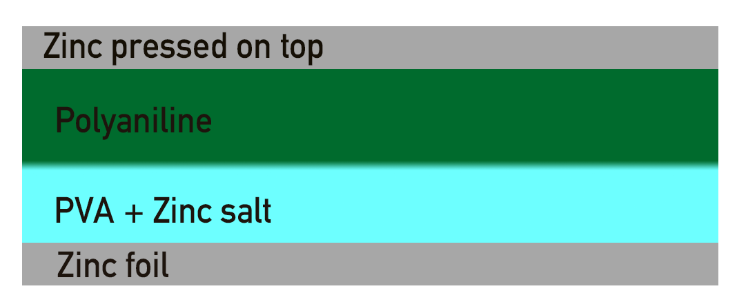
Battery with two layer stratification
Next time in the lab: Using two zinc current collectors

Slide 25
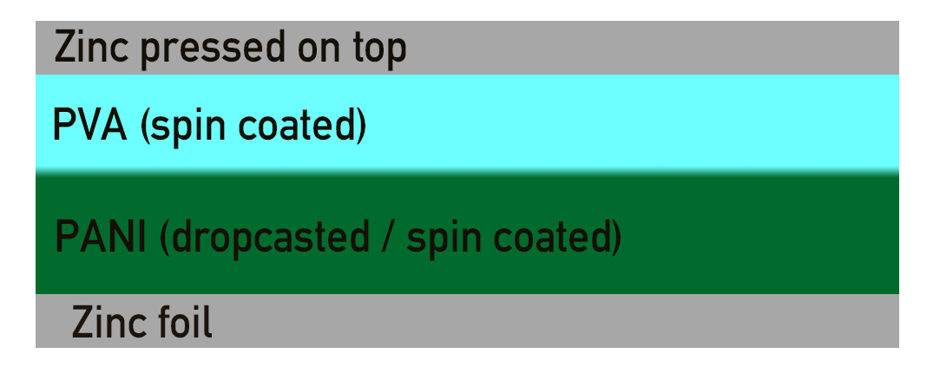
Manual zinc battery
PVA easily solvable in NMP
↯ Spincoating of PANI on top of PVA not possible
→ Building the battery bottom up

Slide 26
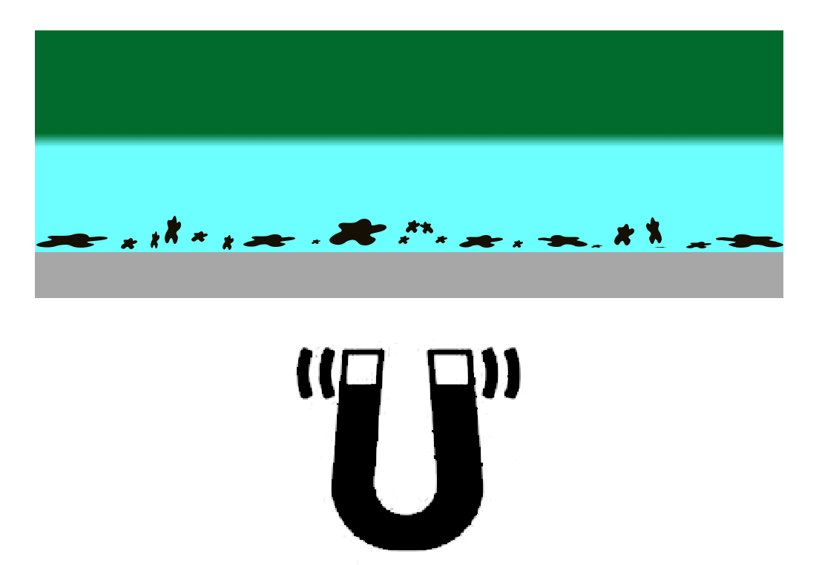
Ways to do three layer stratification
Try stratification by free surface energy mechanism
Not many three-layer stratifications reported in the literature
Complete & reliable stratification is necessary (short circuits!)
Using a magnetic third component to force stratification

Slide 27
Further plan
Build a complete working manual zinc based battery
Determine the surface free energy of the coatings
Use elipsomerty to do advanced testing for self-stratification
…?

